Slide 1







Success factors - SpaceX
Soonyoul Kwon
Xyz@gmail.com
January 18, 2024

Slide 2



Table of Contents
Executive Summary
Introduction
Methodology
Results
Visualization – Charts
Dashboard
Discussion
Findings & Implications
Conclusion
Appendix

Slide 3

EXECUTIVE SUMMARY
Reusing the rockets is key success factor (KSF) of SpaceX
To increase the cost saving effect, the business should focus its resource more on launching the rockets on the area with higher landing success rate.
Not all features has had meaningful impact to the landing success.
There are some factors that had significant impact on the success rate
CCAFS SLC 40 when the payload mass over 10,000.
The heavier payload mass, LEO, ISS, and PO.
KSC LC-39A has the highest success rate.

Slide 4

INTRODUCTION
SpaceX has become an industry leader based on the comparative cost effectiveness.
This is due to the reusability of the rockets
Thus, the successful landing of them is critical
I would like to discuss some success factors that affected the landing performance.

Slide 5

METHODOLOGY
Data collection and wrangling
Exploratory data analysis with SQL & Interactive map with Folium / Plotly Dash dashboard
Predictive analysis

Slide 6
Data collection & wrangling methodology
Data collected from SpaceX API
Data normalization using .jason_normalize()
Data filtering in pandas DataFrame
Imputing missing data (i.e. mean value for null PayloadMass)
Data scrapping using BeautifulSoup
And Parsing data to dictionary to DataFrame
Exploring datasets using df.methods

Slide 7
EDA and interactive visual analytics methodology
SQL
Loading data from csv
Converting to DataFrame
Execute sql queries using %sql
Folium & Dash
Locate coordinates in map using folium
Calculate the distances between coordinates
Draw lines between coordinates
Creating a layout including dropdown implementation
Adding callback functions using inputs and outputs
Exploratory visualization (plots)
matplotlib
seaborn

Slide 8
Predictive analysis methodology
Split train and test data
For each method (logistic regression, support vector machine, decision tree classifier, and k nearest neighbors)
Create object and fit the object to the train data to get the best parameters and accuracy score
Calculate the accuracy on the test data
Visualize false-positive/negative in confusion matrix

Slide 9
Results
EDA with visualization
EDA with SQL
Interactive map with Folium
plotly Dash dashboard
Predictive analysis (classification)

Slide 10
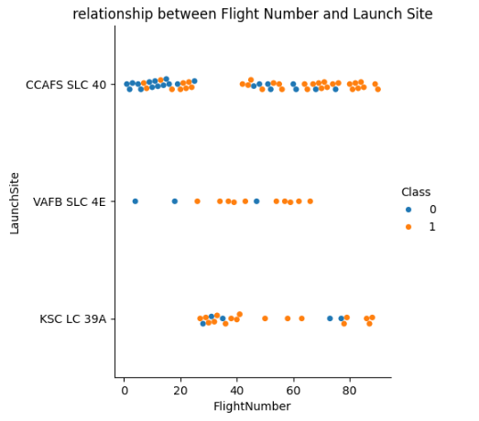
EDA with visualization results 1
Flight Number vs. Launch site scatter chart
Overall, the higher the flight number, the higher chance of successful landing.
This pattern was more obvious for two launch sites: CCAFS SLC 40 and VAFB SLC 4E.

Slide 11
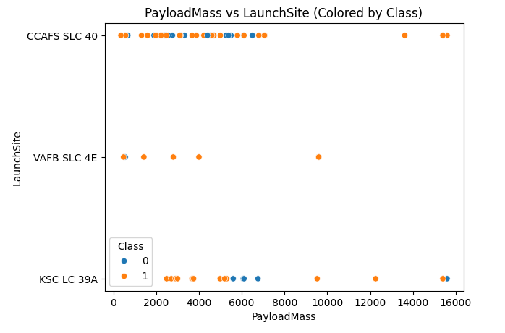
EDA with visualization results 2
Payload vs. Launch site scatter chart
It is noticeable that it was 100% success for the heavy load over 10,000 on the launch site CCAFS SLC 40.

Slide 12
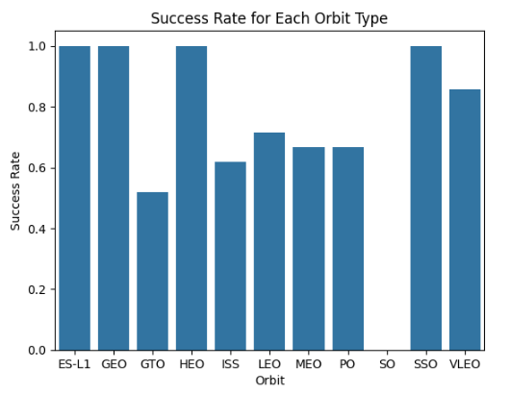
EDA with visualization results 3
Success rate vs. Orbit type bar chart
ES-L1, GEO, HEO and SSO had the highest success rates among all orbits.

Slide 13
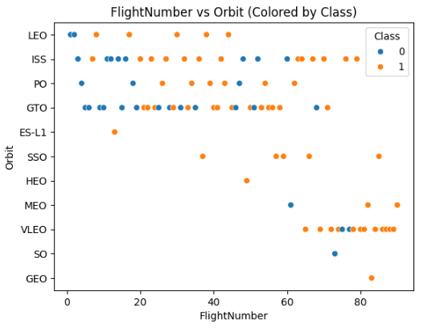
EDA with visualization results 4
Flight Number vs. Orbit type scatter chart
LEO orbit the Success appears related to the number of flights

Slide 14
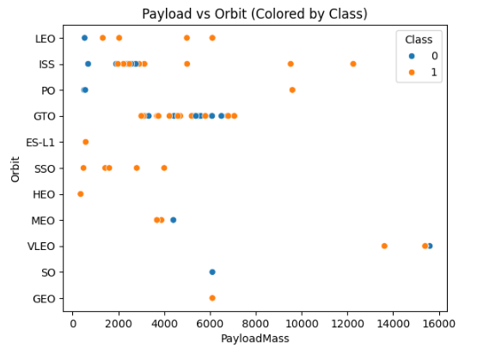
EDA with visualization results 5
Payload vs. Orbit type scatter chart
With heavy payloads the successful landing or positive landing rate are more for Polar, LEO and ISS

Slide 15
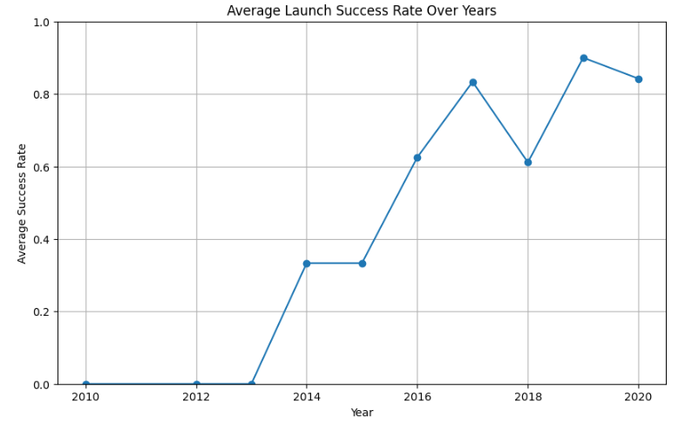
EDA with visualization results 6
Launch success yearly trend line
Rates kept increasing

Slide 16
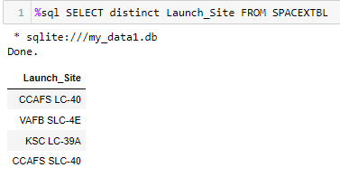
EDA with SQL results 1
All launch site names: Find the names of the unique sites

Slide 17
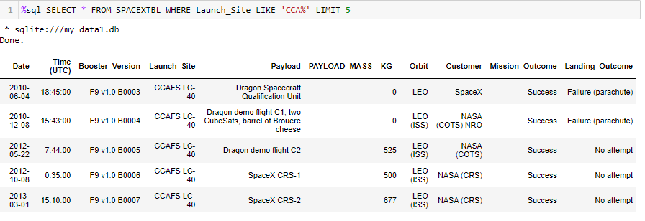
EDA with SQL results 2
Launch site names begin with `CCA`: Find all launch site names begin with `CCA`

Slide 18
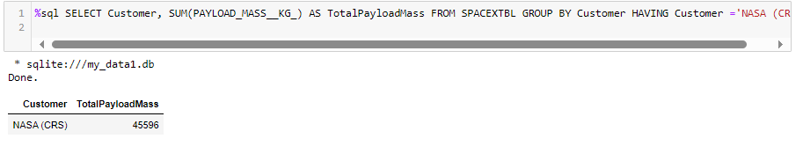
EDA with SQL results 3
Total payload mass: Calculate the total payload carried by booster from NASA

Slide 19
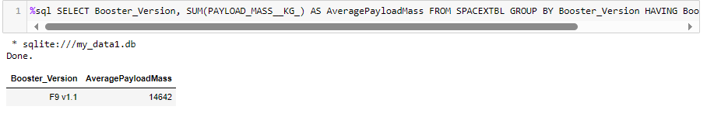
EDA with SQL results 4
Average payload mass by F9 v1.1: Calculate the average payload mass carried by booster F9 v1.1

Slide 20
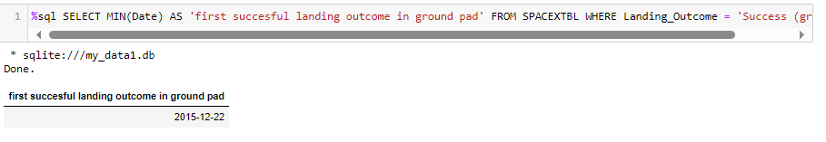
EDA with SQL results 5
First successful ground landing date: find the date when the first successful landing outcome in ground pad

Slide 21
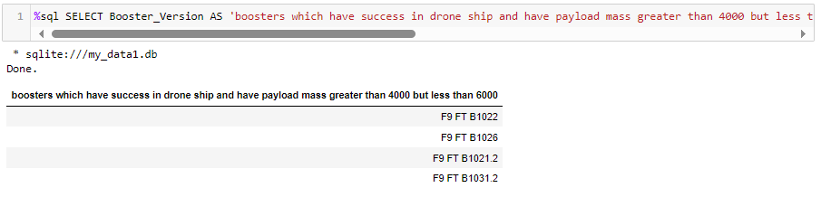
EDA with SQL results 6
Successful drone ship landing with payload between 4000 and 6000: List the names of boosters which have success in drone ship and have payload greater than 4000 but less than 6000

Slide 22
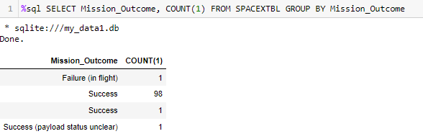
EDA with SQL results 7
Total number of successful and failure mission outcomes: Calculate the total number of successful and failure mission outcomes

Slide 23
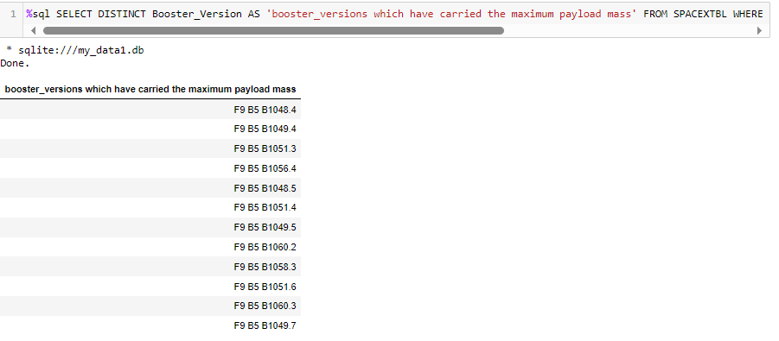
EDA with SQL results 8
Boosters carried maximum payload: List the names of the booster which have carried the maximum payload mass

Slide 24
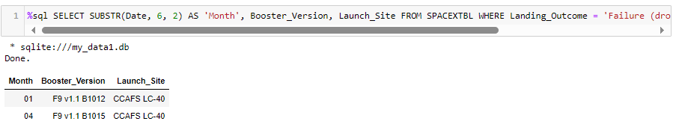
EDA with SQL results 9
2015 launch records: List the launch records for months in 2015

Slide 25
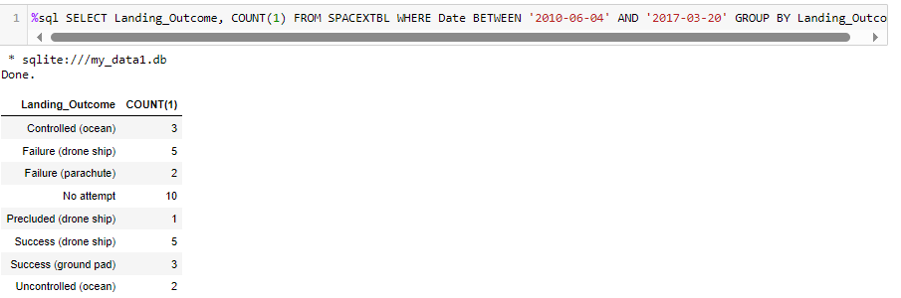
EDA with SQL results 10
Rank success count between 2010-06-04 and 2017-03-20: Rank the count of successful landings between 2010-06-04 and 2017-03-20

Slide 26
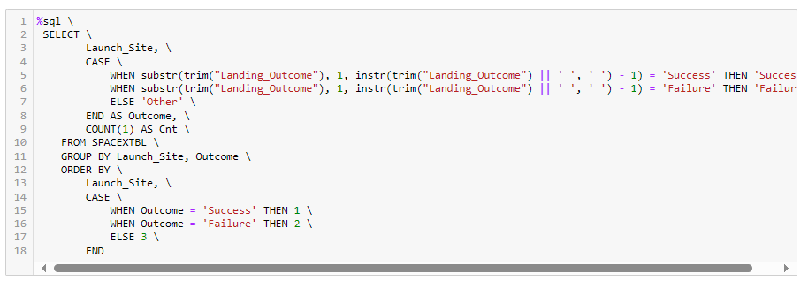
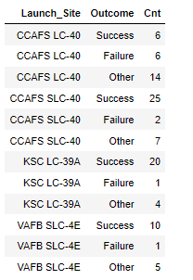
EDA with SQL results - Extra
KSC LC-39A has the highest success rate.

Slide 27
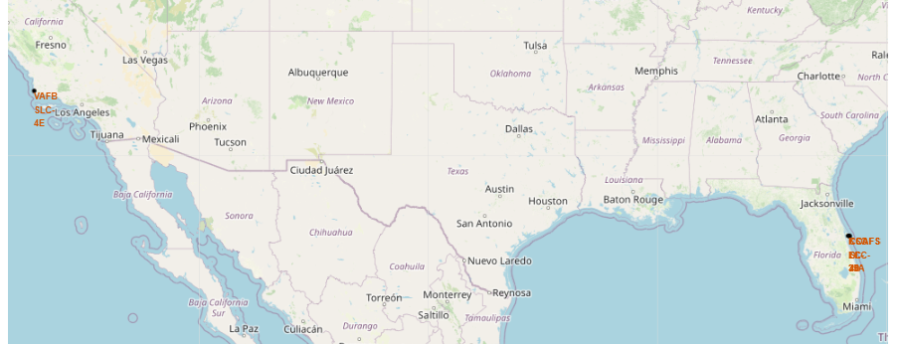
Interactive map with Folium results 1
all launch sites’ markers on a global map

Slide 28
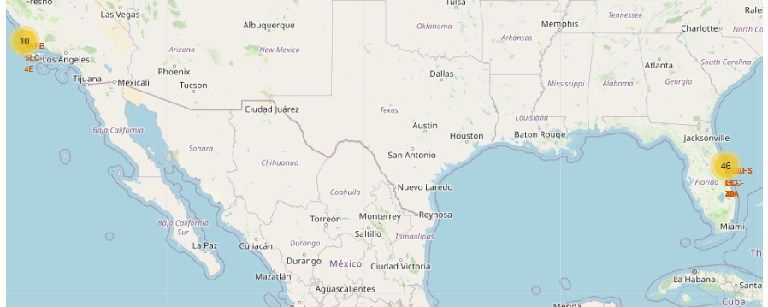
Interactive map with Folium results 2
all launch records per site on the map

Slide 29
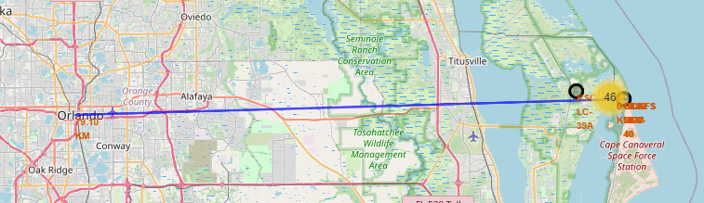
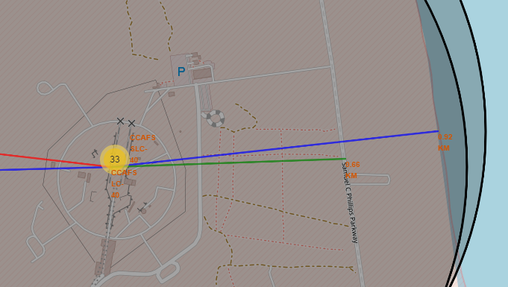
Interactive map with Folium results 3
launch sites’ proximities
Distances from CCAFS LC 40
To the closest shore: 0.92km
To the closest highway: 0.66km
To the closest city (Orlando, FL): 9.10km

Slide 30
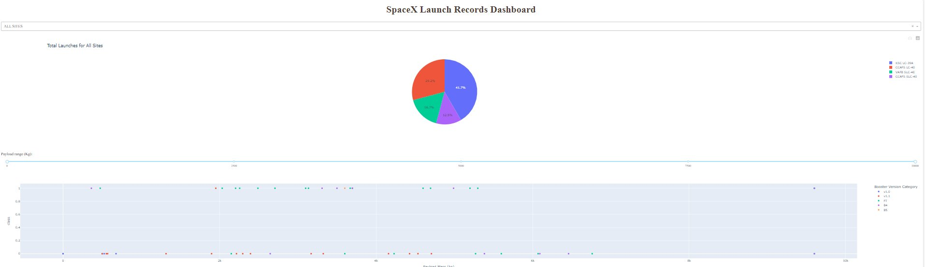
plotly Dash dashboard results

Slide 31
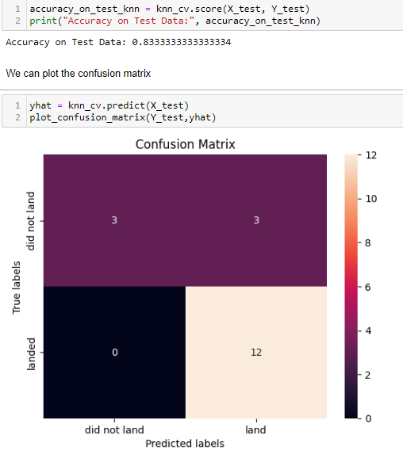

Predictive analysis (classification) results 1
KNN model performance

Slide 32
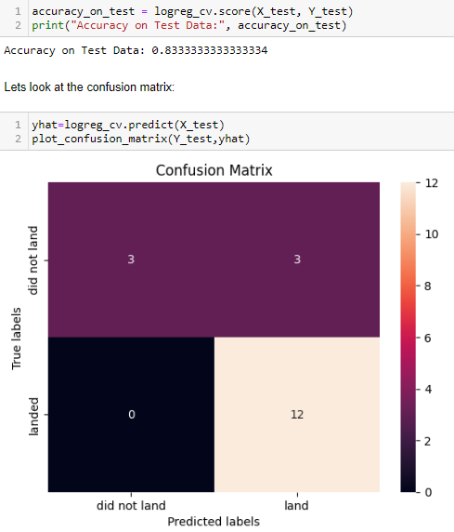

Predictive analysis (classification) results 2
Logistic regression model performance

Slide 33
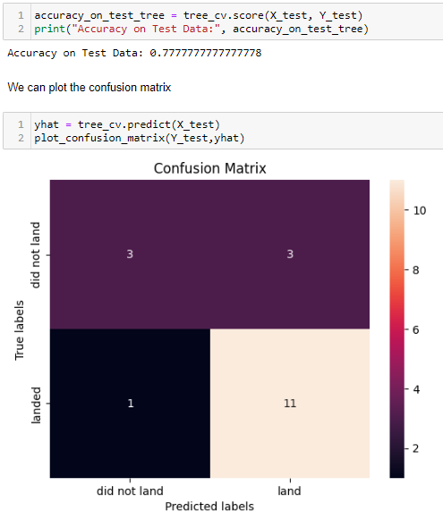
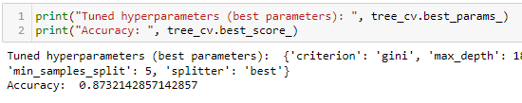
Predictive analysis (classification) results 3
Decision tree model performance

Slide 34


Predictive analysis (classification) results 4
SVM model performance

Slide 35
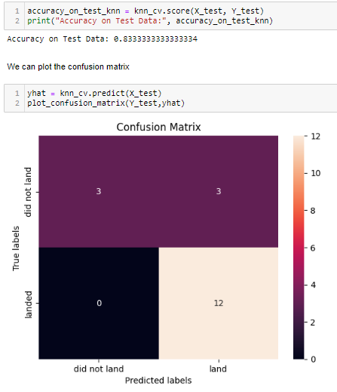
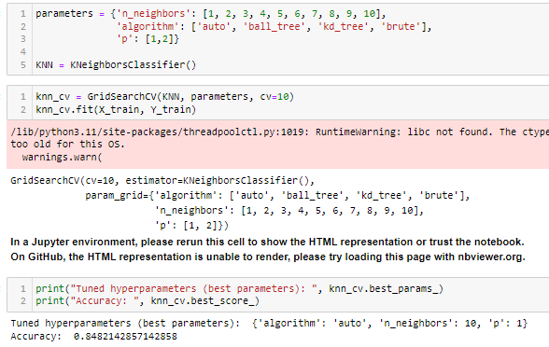
Predictive analysis (classification) results 5
All models tested had three false-negative but a decision tree classifier had one more false-negative than the other models.
K-nearest neighbors(knn) had the highest accuracy score among all models.

Slide 36
DISCUSSION
Decision-tree classifier
The 'max_features' parameter should be set to an integer, a float, a string ('log2' or 'sqrt'), or None. 'auto' that were taught and provided from the instruction is replaced with None.
Accuracy vs run-time
The accuracy of the model was not noticeably different among the models used.
Decision tree and kNN took more resource and time for fitting the models to the test data than the logistic regression and SVM.
Assuming the quality of dataset stay similar, the trade-off between accuracy and resource consumption should be considered when volume of data is significant.

Slide 37
OVERALL FINDINGS & IMPLICATIONS
Findings
For the launch site CCAFS SLC 40 only, high success rate for the payload mass over 10,000.
The heavier Payload mass, the higher success rate for the three orbits: LEO, ISS, and PO.
KSC LC-39A has the highest success rate.
Put more resources to the combination of the launch site, payload and the orbit that has had higher success rate.

Slide 38

CONCLUSION
Among many factors (features), some were indifferent with respects to the success rate.
However, some had definitely influenced more on the success rate of the landing scenario.
So, the company should focus more on the combination of the success factors by putting more resources to them to increase a chance of reusing the rocket and reduce its cost.

Slide 39
APPENDIX
Rocket launch data from SpaceX API
https://api.spacexdata.com/v4/launches/past
List of Falcon 9 and Falcon Heavy launches Wikipage updated on 9th June 2021
https://en.wikipedia.org/w/index.php?title=List_of_Falcon_9_and_Falcon_Heavy_launches&oldid=1027686922

